Slide 1
第8-4章: Network Motifs
Milo, R., et. al. Science 298, 824–827, 2002.
Milo, R., et al. Science 303, 1538-1542, 2004.
Rui Jiang, Zhidong Tu, Ting Chen, and Fengzhu Sun. Proc. Natl. Acad. Sci. USA, 103, 9404-9409, 2006.
Slides for this part are mainly from Fengzhu Sun’s talk.

Slide 2
Network Motif
Definition: Patterns of interconnections occurring in complex networks at numbers that are significantly higher than those in randomized networks (Milo, R., et. al. Science 298, 824–827)

Slide 3
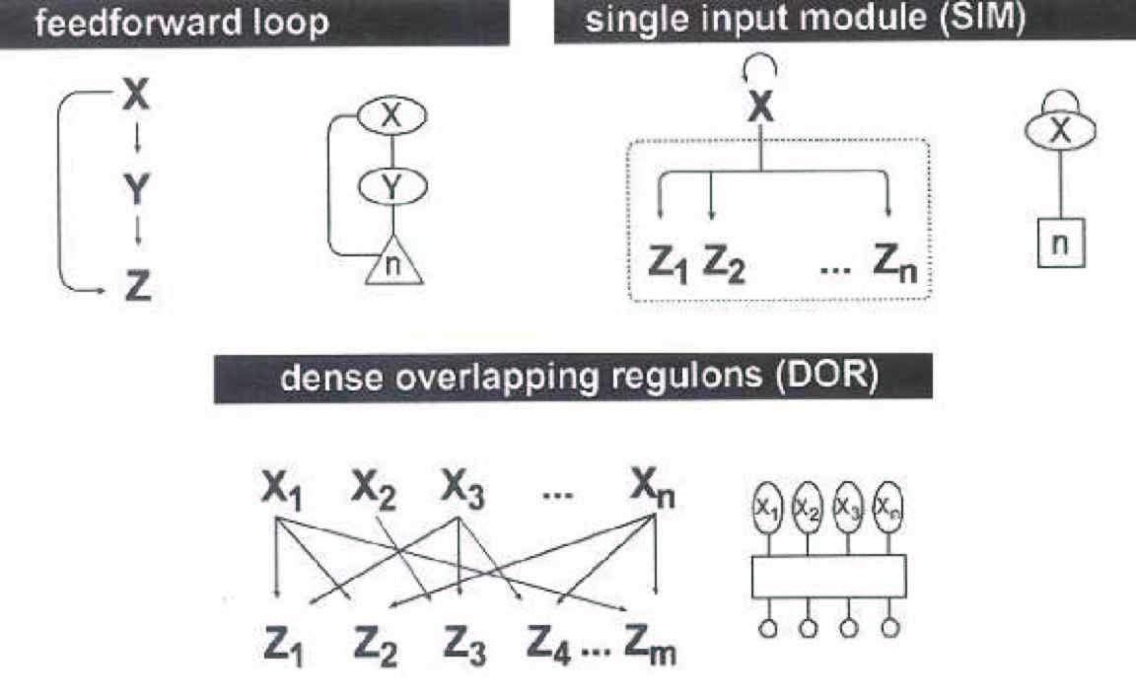
Network Motifs
Milo et al. Science, 298, 2002

Slide 4
Existing Methods for Network Motif Identification
Consider different types of subgraphs separately
For each type of subgraph
Count the number of occurrence of the subgraph in the observed network
Shuffle the observed network to obtain a set of randomized networks. Estimate the expected number of occurrence of the same type of subgraph in the randomized networks
Calculate a statistic corresponding to the subgraph
Over-abundant subgraphs are network motifs

Slide 5
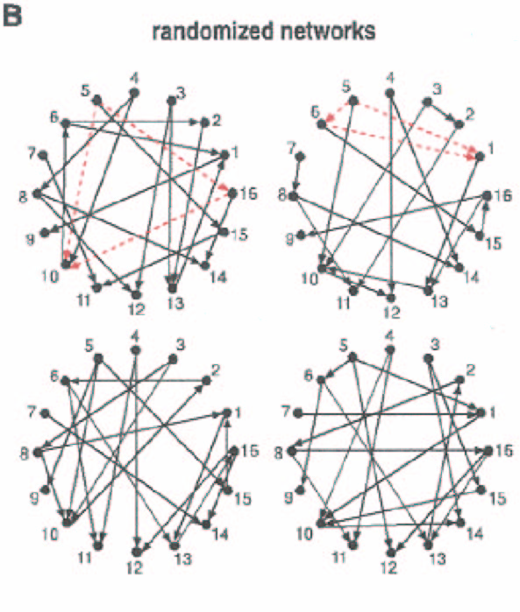
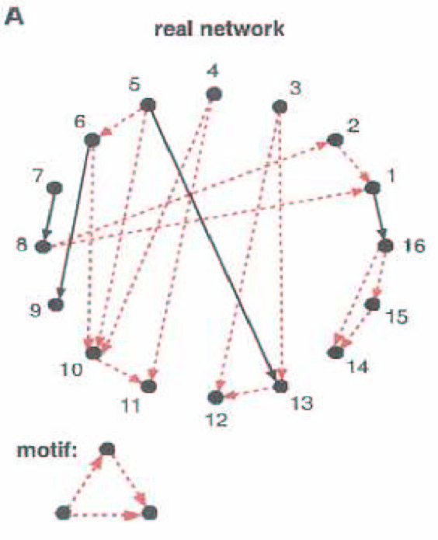
Schematic Illustration
Red dashed line indicate edges that participate in the feedforward loop motif, which occur five times in the real network.

Slide 6
Randomized Network
It employed a Markov-chain algorithm, based on starting with the real network and repeatedly swapping randomly chosen pairs of connections (X1->Y1, X2 ->Y2 is replaced by X₁->Y₂, X₂->Y₁) until the network is well randomized.
Switching is prohibited if the either of the connections X₁->Y₂ or X₂->Y₁ already exist.

Slide 7
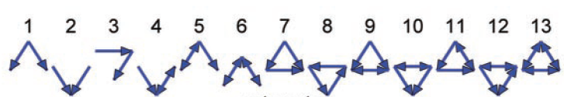
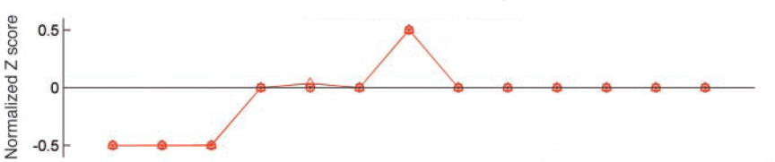
Network Motif Identification in Deterministic Networks
Hypothesis testing
A | 1 | 2 | 3 | 4 | 5 | 6
1 | 0 | 1 | 0 | 1 | 0 | 0
2 | 0 | 0 | 1 | 0 | 0 | 0
3 | 0 | 0 | 0 | 1 | 0 | 1
4 | 0 | 0 | 0 | 0 | 1 | 0
5 | 0 | 1 | 0 | 0 | 0 | 1
6 | 1 | 0 | 0 | 0 | 0 | 0
时间复杂度
mN^{n}
Milo et al. Science, 303, 2004

Slide 8
Network Motif Identification in Stochastic Networks
P | 1 | 2 | 3 | 4 | 5 | 6
1 | 0 | .9 | 0 | .6 | 0 | 0
2 | 0 | 0 | .9 | 0 | 0 | 0
3 | 0 | 0 | 0 | .9 | 0 | .6
4 | 0 | 0 | 0 | 0 | .9 | 0
5 | 0 | .6 | 0 | 0 | 0 | .9
6 | .9 | 0 | 0 | 0 | 0 | 0
时间复杂度
lmN^{n}
Θ₁ | 1 | 2 | 3
1 | θ₁₁ | θ₁₂ | θ₁₃
2 | θ₂₁ | θ₂₂ | θ₂₃
3 | θ₃₁ | θ₃₂ | θ₃₃
Mixture model
EM algorithm
Likelihood ratio test
Jiang et al. Proc Natl Acad Sci USA, 103, 2006

Slide 9
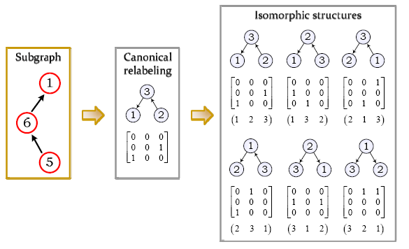
Subgraph
Isomorphic structures of a subgraph

Slide 10
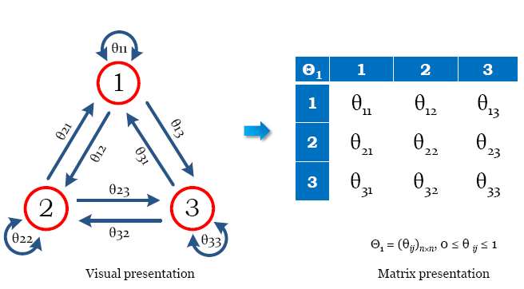
Probabilistic Network Motifs

Slide 11
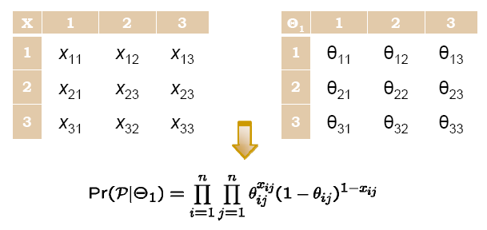
Probabilistic Network Motifs
How to match an isomorphic structure of a subgraph to a probabilistic network motif?

Slide 12
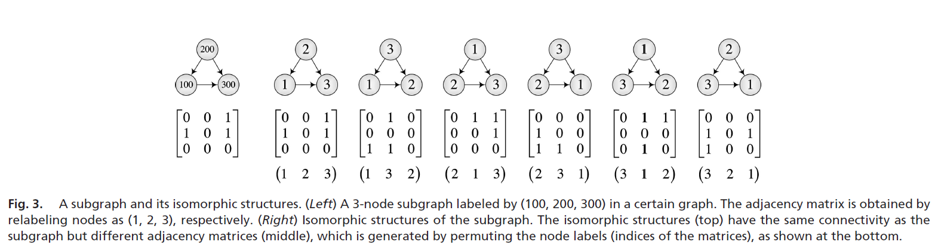
Isomorphic Structure
A permutation of the canonical labels corresponding to a certain isomorphic structure.

Slide 13
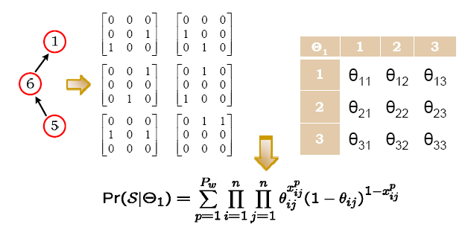
Probabilistic Network Motifs
How to match a subgraph to a network motif?
Where Pw is the number of isomorphic structures.

Slide 14
A Mixture Model for Network Motif Identification
A stochastic network = Foreground probabilistic network motif (λ) +Background random ensemble (1-λ)
Network motif identification procedure
Sample from the stochastic network to obtain a set of subgraphs ― Observation
For each subgraph, determine whether it comes from the foreground or the background ― Missing
For each subgraph, determine a proper isomorphic structure to derive the foreground motif pattern or to match the background random ensemble ― Missing

Slide 15
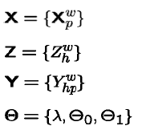
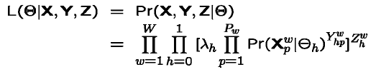
Mathematical Formulae
Observation
Missing data 1
Missing data 2
Parameters
Pseudo-likelihood function
Maximize L to estimate parameters

Slide 16
An EM Algorithm
The parameters associated with the background (Θ0) can be estimated offline in advance
E-step: Calculate the expectation of the log pseudo-likelihood, conditional on the observation X and the current estimation of the parameters λ and Θ1
M-step: Maximize the expectation of the log pseudo-likelihood to update the estimation of the parameters λ and Θ1
Iterate over the E-step and M-step

Slide 17
Statistical Significance of the Identified Network Motifs
A hypothesis testing problem
H₀: λ= 0 versus H₁: λ> 0
A pseudo-likelihood ratio statistic
LR=-2log(L₀/L₁)
A simulation method
Calculate LR* for the given stochastic network
Simulate a number of randomized networks, apply the EM algorithm, calculate LRs
Count how many LR from the randomized networks are greater than LR* from the given stochastic network

Slide 18
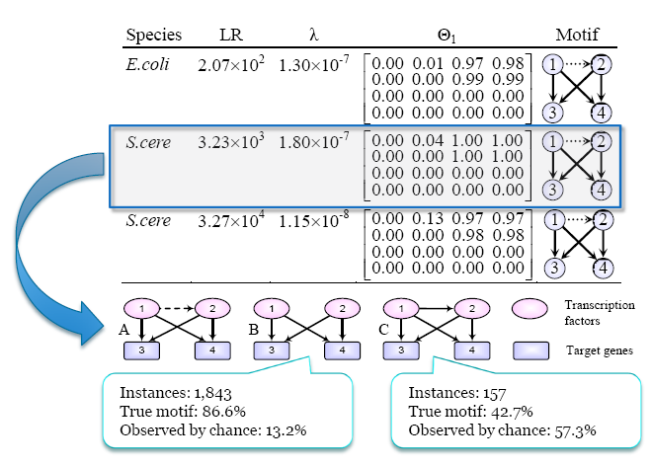
A Novel Stochastic Bi-fan Motif

Slide 19
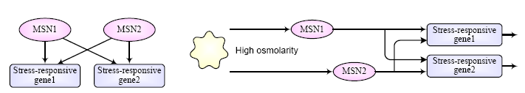
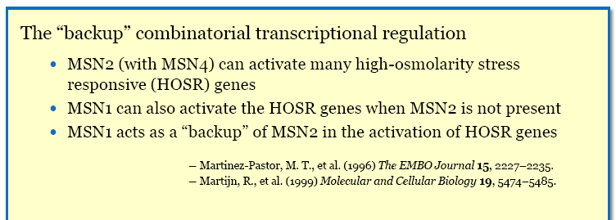
The high-osmolarityglycerol (HOG) Stress Response Pathway

